Slide 1

IACS Capstone Project Course
DataShack 2018

Slide 2
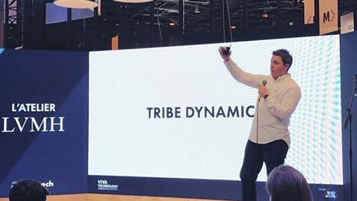
WHO IS TRIBE DYNAMICS
Consulting San Francisco based startup
Around 50 people in the company, mostly non-specialized ones
Measure social media engagement for beauty, fashion and lifestyle brands

Slide 3

WHAT DO THEY DO
Clients want to know how much people are talking about them on social media, versus their competitors
Tribe provides them a metric on this, so companies can value their social media campaigns
Weighted average of likes, comments, shares, and so on

Slide 4

WHO ARE TRIBE’S CLIENTS
Leading brands in the beauty, fashion and lifestyle industries
Mostly related to cosmetics
Clients want to get a general understanding of digital trends within the beauty industry

Slide 5
WHO ARE WE

Slide 6


Is this post about «Sephora?»
What is the topic in this post?

Slide 7
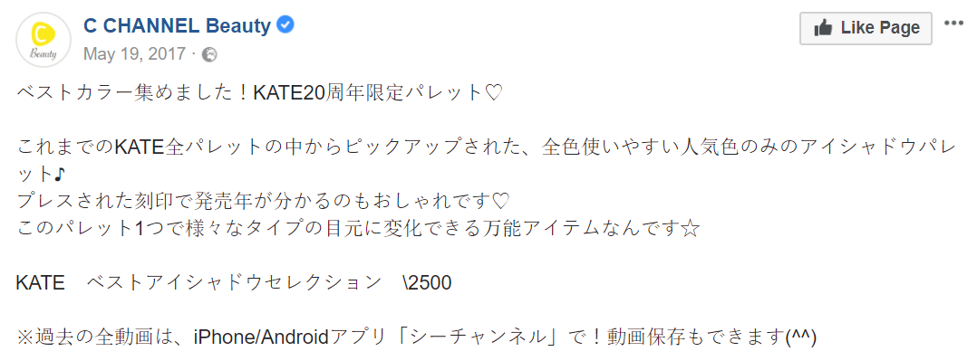

But what about here?

Slide 8
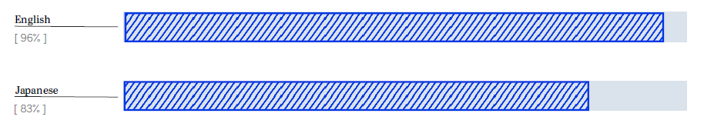
HEAVY PERFORMANCE DROP
Tribe promises 95% accuracy to their clients

Slide 9

WHAT IS THE PROBLEM
Processing natural language in different languages is hard
The availability of resources and training data in English led to a disproportionate focus on the English language
Few attentions have been paid to all the other languages that are spoken around the world

Slide 10

WHY SHOULD WE SOLVE THIS PROBLEM
As the company expands internationally to Europe and Asia, it must be able to target those markets too, even though the posts are not written in English
It is important that we find a solution

Slide 11

APPROACH #1: MACHINE TRANSLATION
Does not scale very well
APIs use might become large (and costly) very quickly

Slide 12
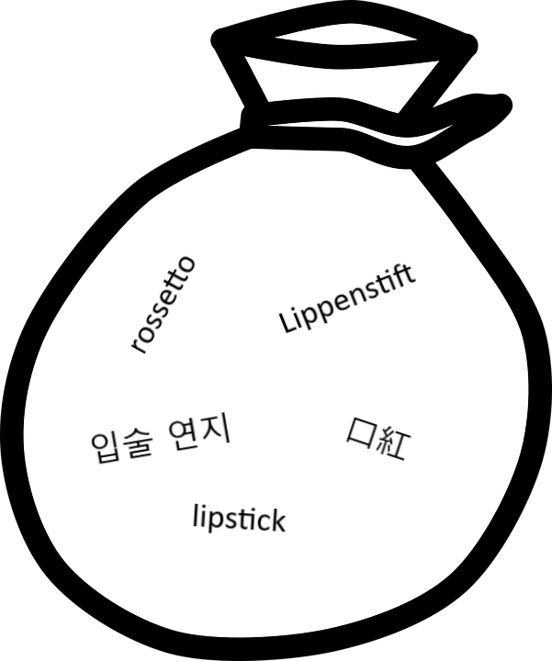
APPROACH #2: ONE GIGANTIC VOCABULARY
Train the model by creating a huge vocabulary comprising all languages
Empirically works
There is a lot of room for improvement

Slide 13
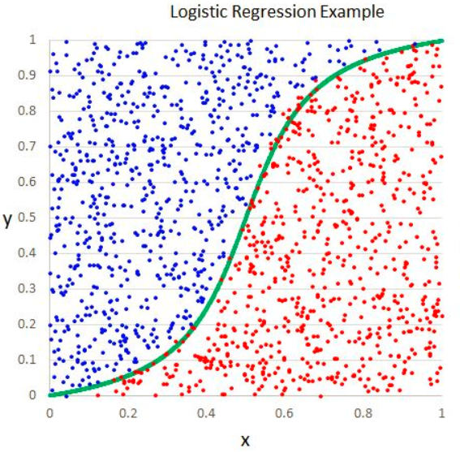
TRIBE’S CURRENT APPROACH
n-gram from words across languages
Logistic regression used for classification tasks
Problem: Creating n-grams is cumbersome and inefficient, particularly in unknown languages

Slide 14
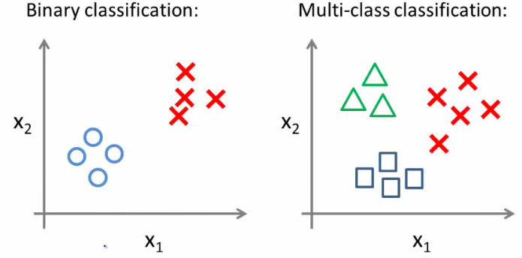
HOW DO THEY APPLY THEIR MODEL
Binomial Task
«Is this post about Maybelline or not?»
Multinomial Task
«What is this post about?»
Answers: beauty, fragrance, skincare, haircare, etc.

Slide 15
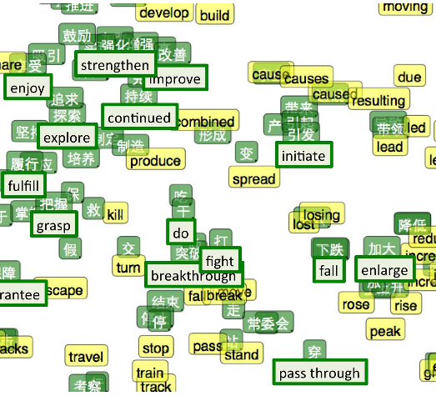
WHAT’S THE PATH TO A SOLUTION
Transfer Learning
Active Learning
Latent Space Representation (Encoding)

Slide 16
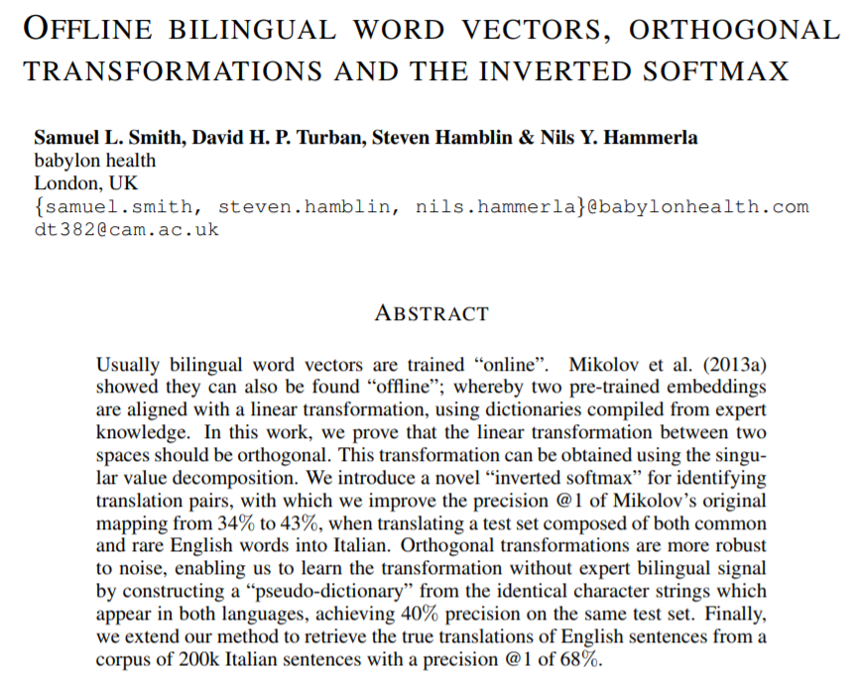
ADVANTAGES (1/2)
Pre-Trained
Code and embeddings are available open-source
Can be trained for new languages
Facebook recently trained this for 204 languages through social media
Works with any classifier/future task

Slide 17
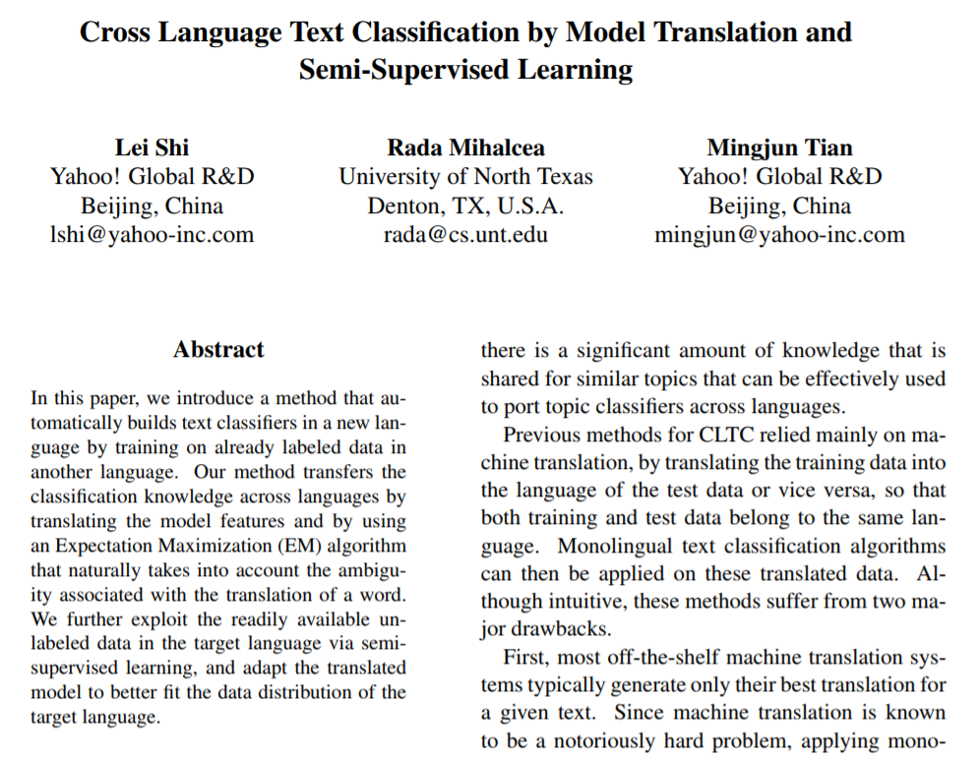
ADVANTAGES (2/2)
No need of machine translation
Labeled data in source
Semi-supervised feedback in target
EM to pick and match distributions in target space

